Slide 1
بسم الله الرحمن الرحيم

Slide 2
Features
There is a nested course category.
Live courses.
Free and paid content.
Ability for any teacher to upload his courses.
Profile page for each student which he can track his courses and his achievements.
Students get points for learning.
Students can rate a course.
Students can comment on each course session.
Teacher can email his students and vise versa.
Teachers can put tasks in there courses and students get points for solving them.
Provide a certificate of completion after every course.

Slide 3
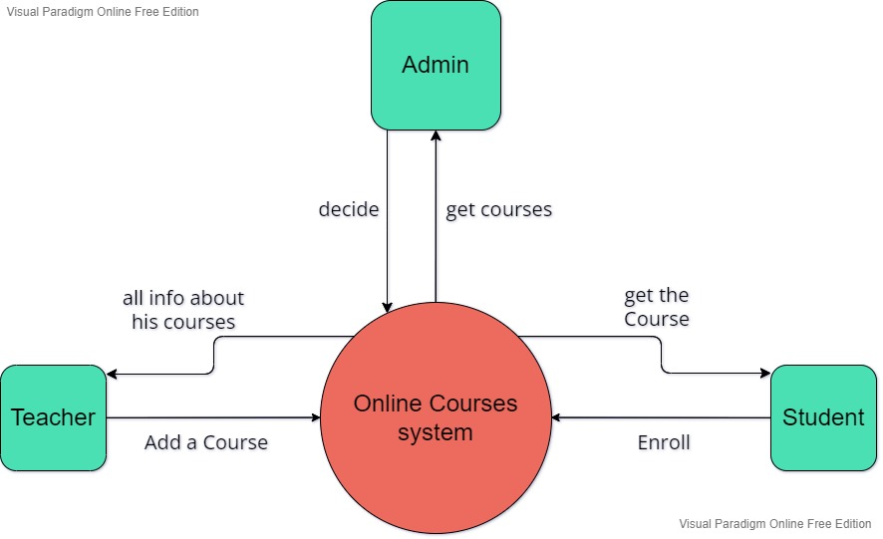
Context diagram 1

Slide 4
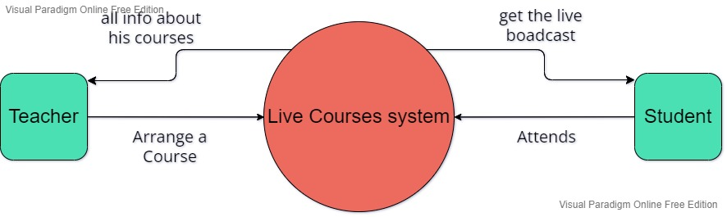
Context diagram 2

Slide 5
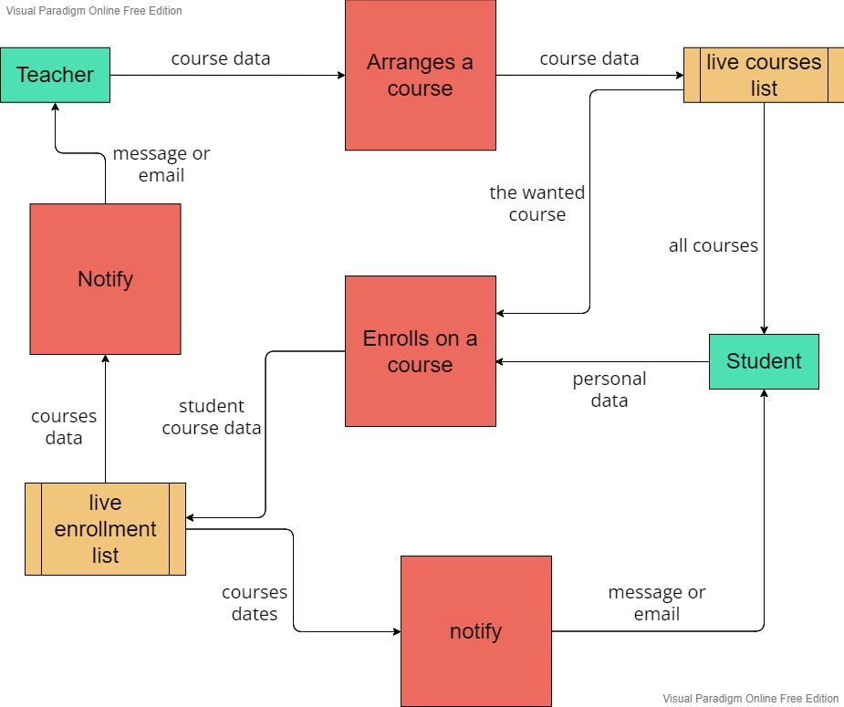
DFD lvl 1.1

Slide 6
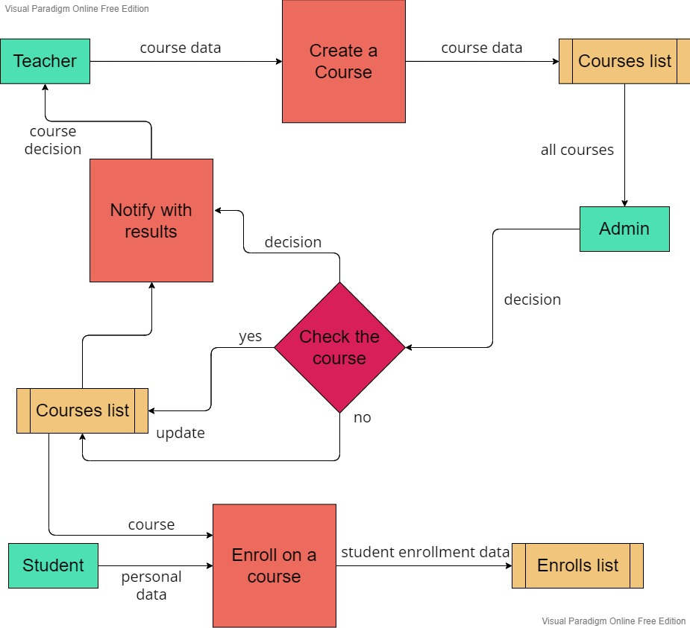
DFD lvl 1.2

Slide 7
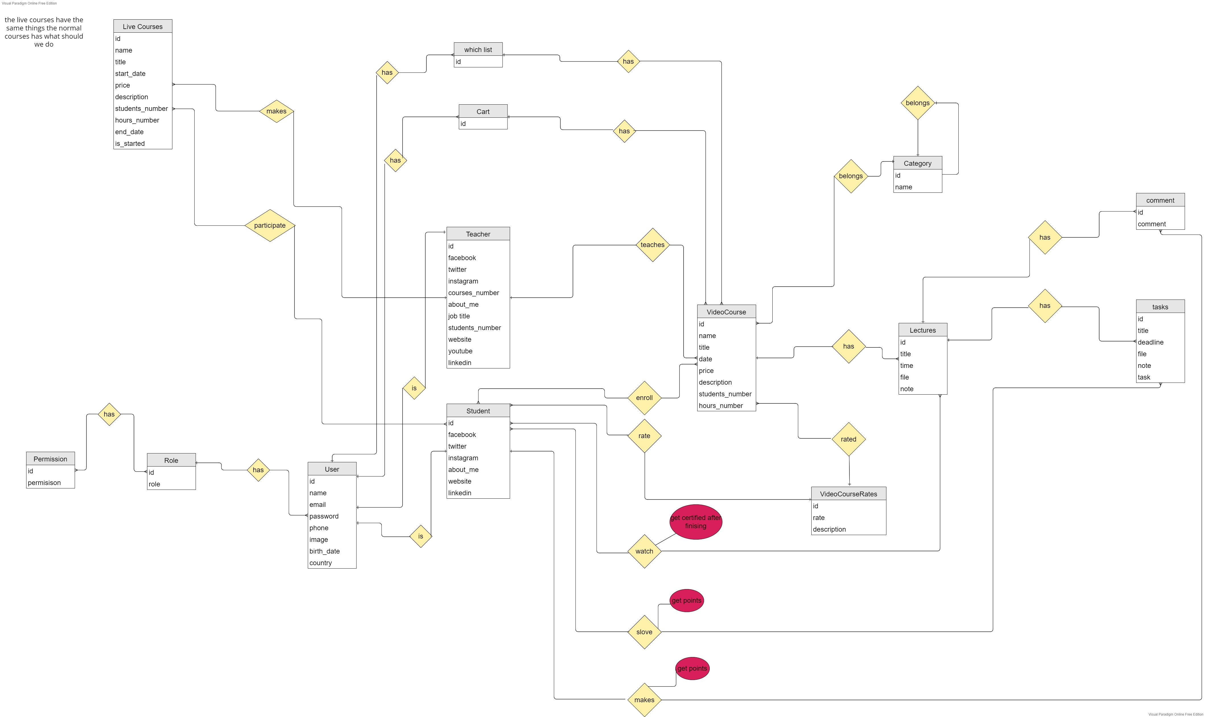
ERD

Slide 8
Mentors and groups for each student.
Every thing is free.
Live is only for mentors.

